Slide 1
ADVANCED Programming for HTML5&CSS
Wen-Yen Wang

Slide 2
Images in html5
https://www.w3schools.com/html/html5_intro.asp
https://www.html5rocks.com/en

Slide 3
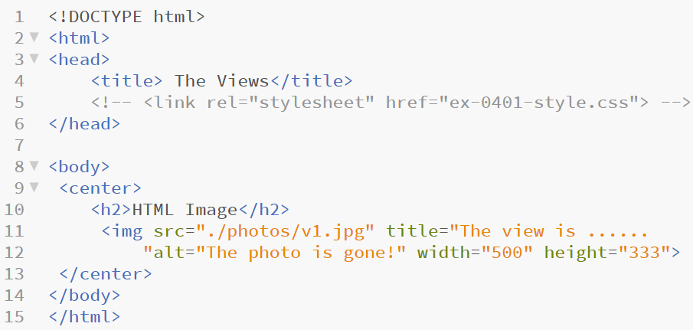
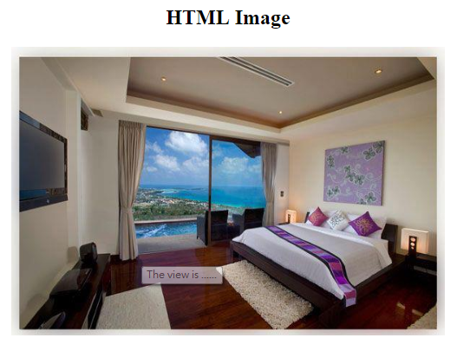
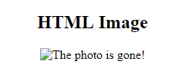
<img>
ex-0401.html
week 6

Slide 4
<img>: title and alt
HTML img title 與 img alt 的差別在於＂使用的目的與呈現效果＂兩方面，簡單來說 img title 與 img alt 是兩個不同的東西，img title 是圖片標題，有點類似網頁標題的意思，用來標示圖片的說明文字，當滑鼠移到圖片上就會自動顯示出來，而 img alt 可就完全不同囉！img alt 是圖片的替代文字，所謂替代文字的意思就是在圖片失效的時候所要呈現的文字，如果圖片可以正常顯示，則 img alt 就不會有任何的功能。

Slide 5
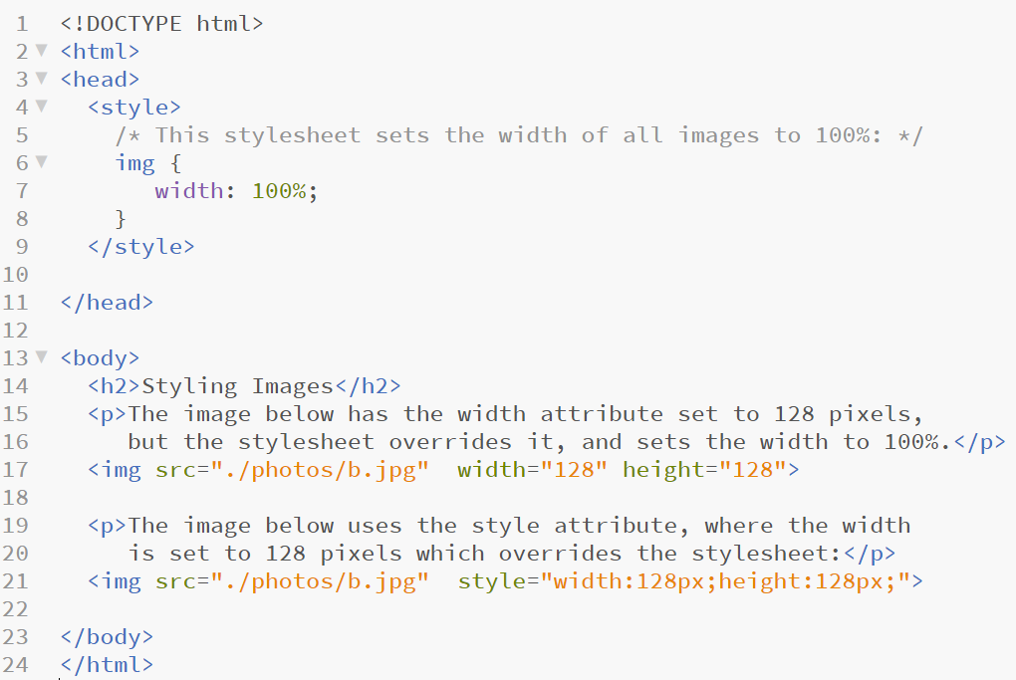
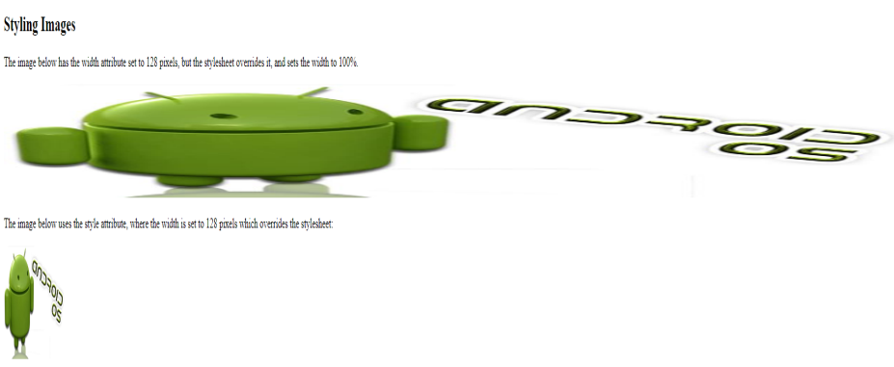
Image Size
ex-0402.html

Slide 6
Path used
Absolute path in html5
Relative path in html5

Slide 7
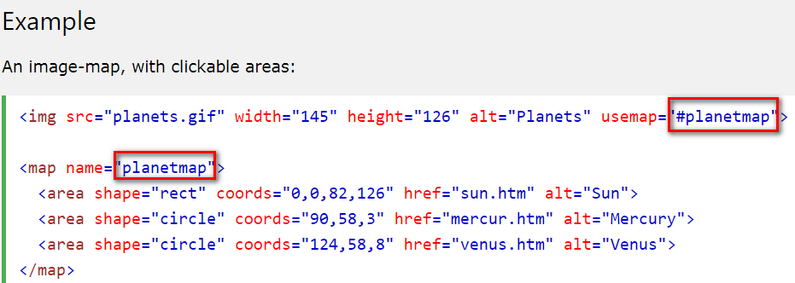
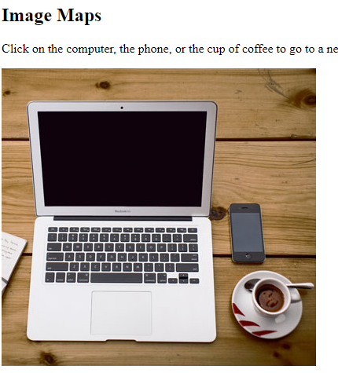
Image Maps
The <map> tag defines an image-map. An image-map is an image with clickable areas.
In the image below, click on the computer, the phone, or the cup of coffee:
The name attribute of the <map> tag is associated with the <img>'s usemap attribute and creates a relationship between the image and the map.
The <map> element contains a number of <area> tags, that define the clickable areas in the image-map.

Slide 8
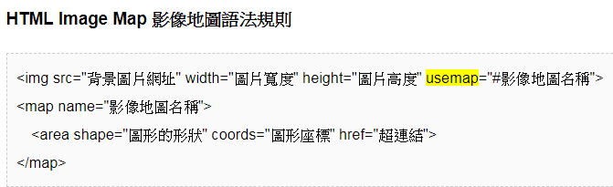
Image maps - syntax

Slide 9
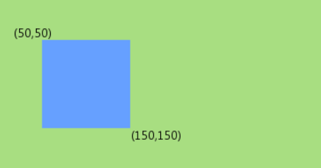
Image Maps
Used shapes:
方形影像地圖的 <area> 設定範例：
<area shape="rect" coords="X1,Y1,X2,Y2" href="超連結">
圓形影像地圖的 <area> 設定範例：
<area shape="circle" coords="圓心 X,圓心 Y, 半徑" href="超連結">
不規則影像地圖 <area> 設定範例：
<area shape="polygon" coords="點座標 1,點座標 2, ..." href="超連結">
FYI:
Where is the (0, 0)
in map area?

Slide 10
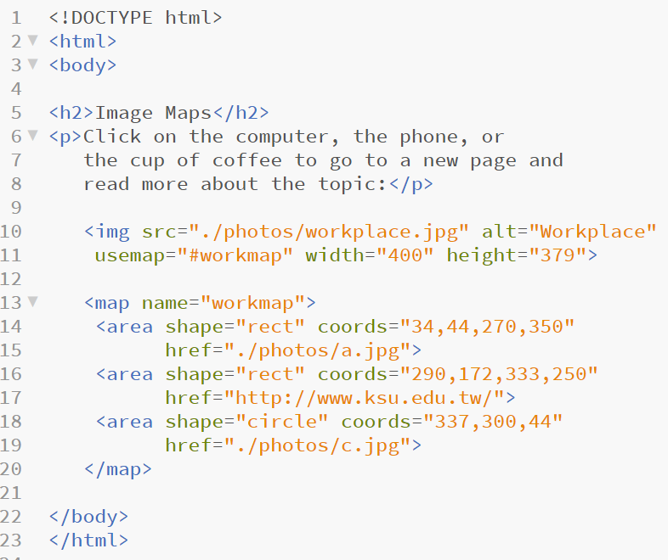
Image Maps
ex-0403.html

Slide 11
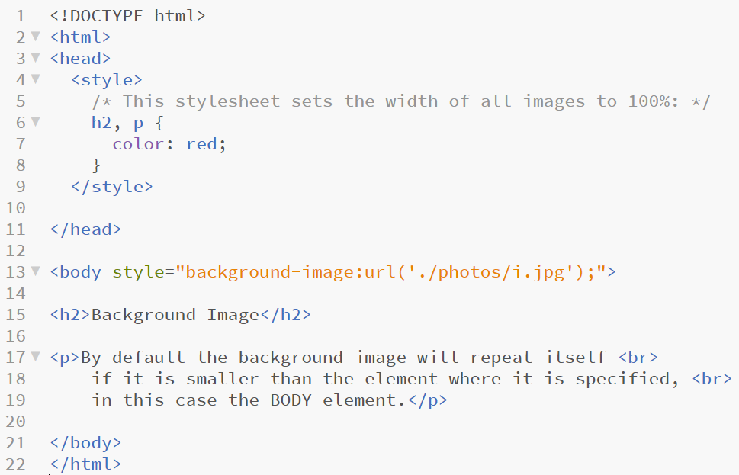
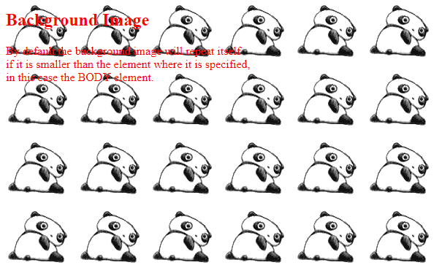
Background Image in <body>
ex-0404.html

Slide 12
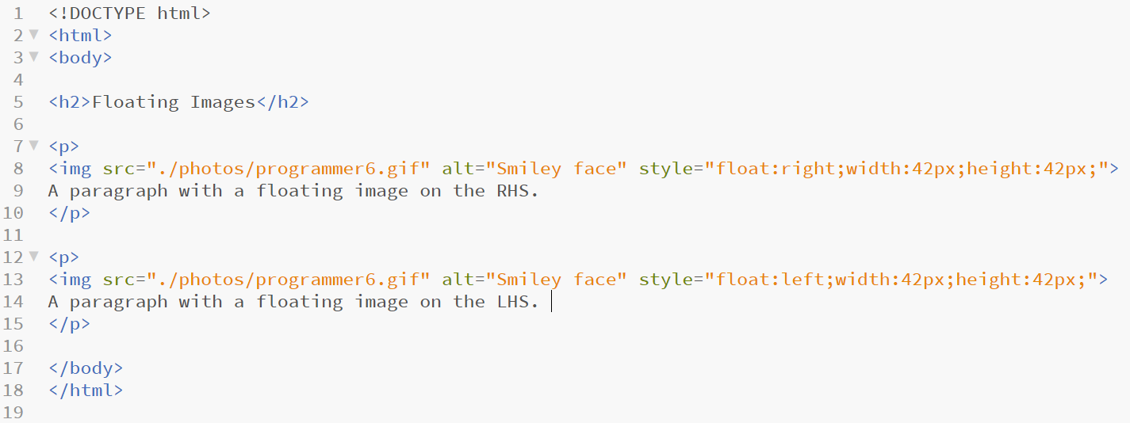
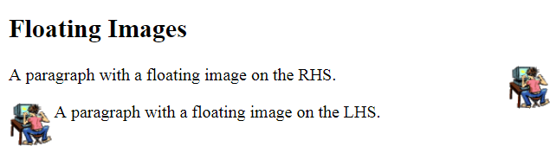
Image Floating
Use the CSS float property to let the image float to the right or to the left of a text:
ex-0406.html

Slide 13
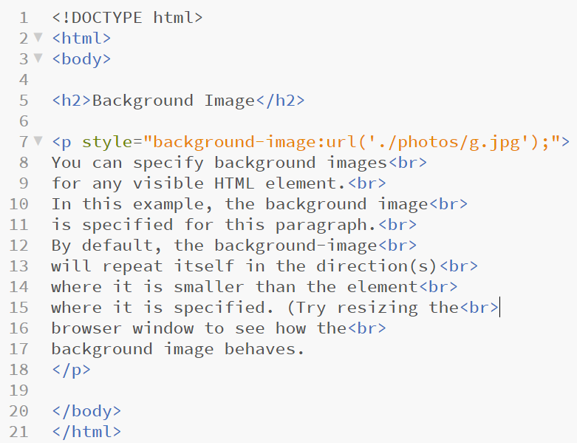
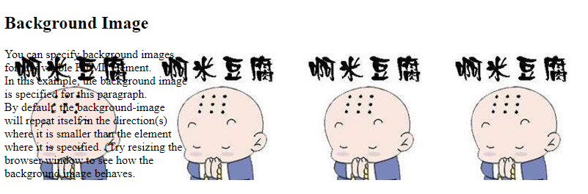
Background Image in <p>
ex-0408.html

Slide 14
Tables in html5
https://www.w3schools.com/html/html5_intro.asp
https://www.html5rocks.com/en

Slide 15
Defining an HTML Table
An HTML table is defined with the <table> tag.
Each table row is defined with the <tr> tag.
A table header is defined with the <th> tag.
By default, table headings are bold and centered.
A table data/cell is defined with the <td> tag.

Slide 16
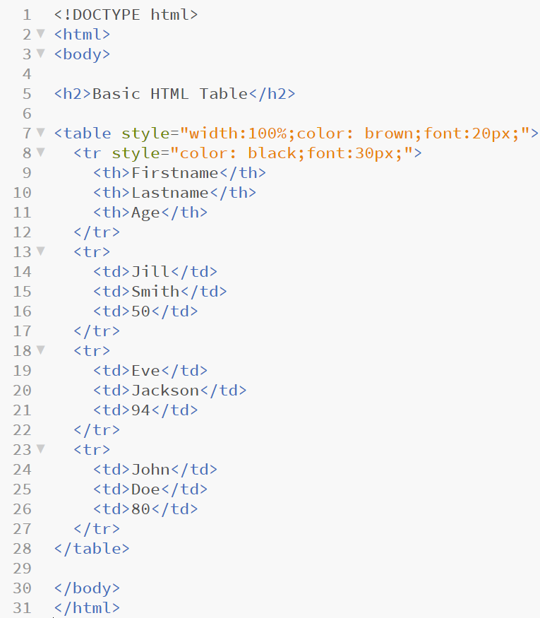
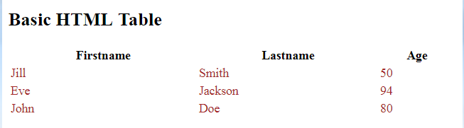
Background Image in <p>
ex-0409.html

Slide 17
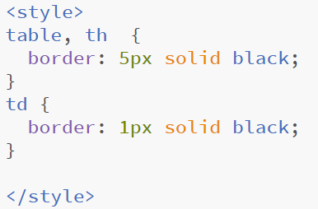
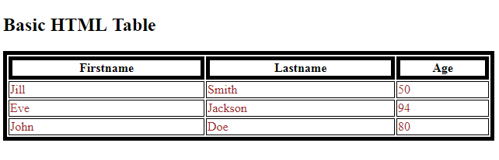
Adding a Border
If you do not specify a border for the table, it will be displayed without borders.
A border is set using the CSS border property:
ex-0411.html

Slide 18
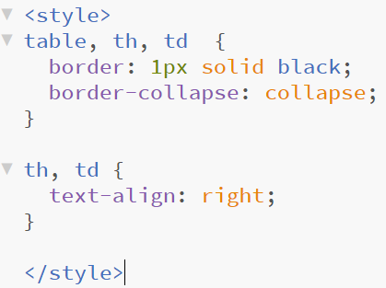
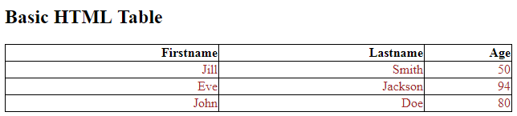
Adding a Border
If you do not specify a border for the table, it will be displayed without borders.
A border is set using the CSS border property:
ex-0413.html

Slide 19
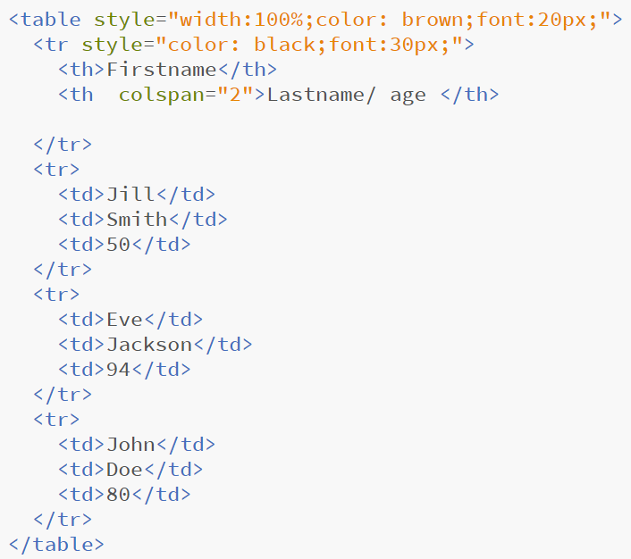
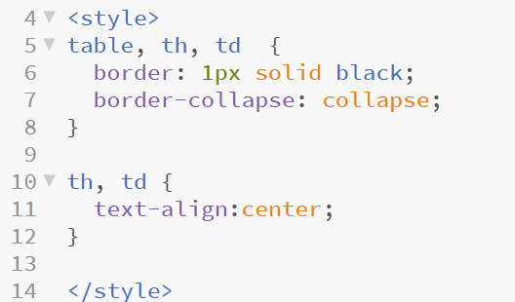
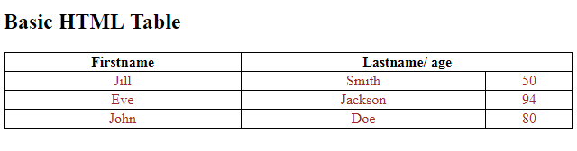
Adding a Border
ex-0414.html

Slide 20
The End

